Slide 1


Unit 1: Lesson 2
Parents and children

Slide 2
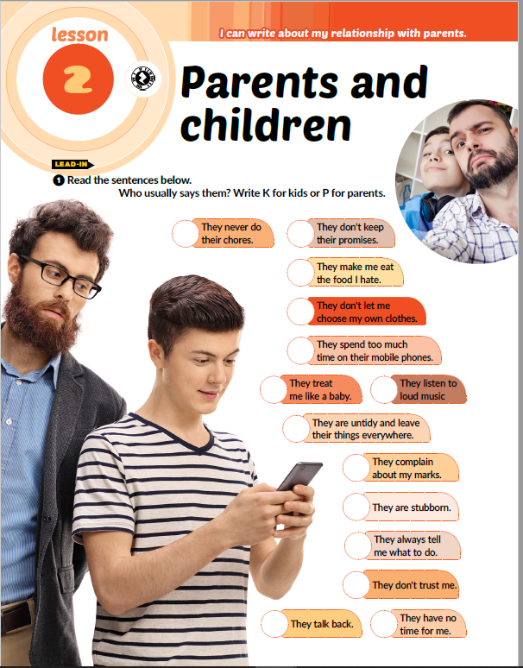
Task ❶ Read the sentences below. Who usually says them? Write K for kids or P for parents.
P
K
K
K
P
K
P
P
K
P
K
K
P
K

Slide 3
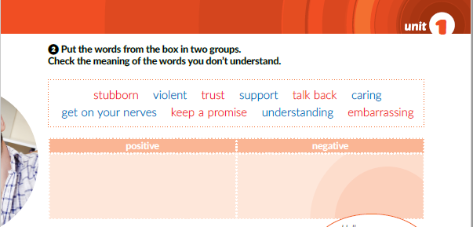
trust
support
caring
keep a promise
understanding
stubborn
violent
talk back
get on your nerves
embarrassing

Slide 4
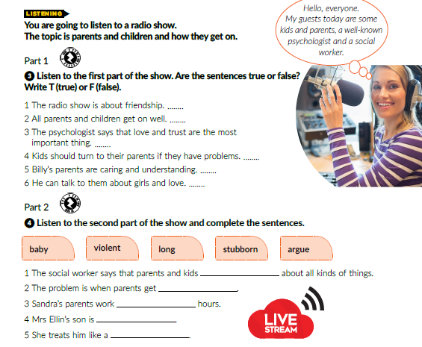
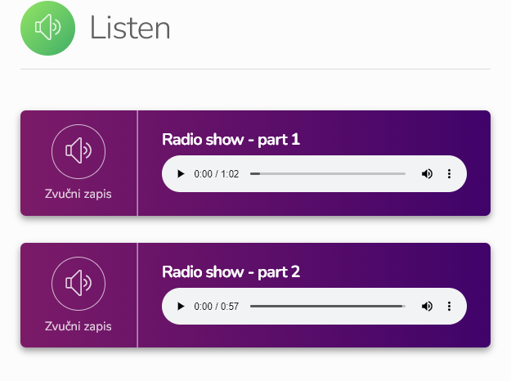
T
F
T
T
T
F
https://www.e-sfera.hr/dodatni-digitalni-sadrzaji/e458989f-5645-4c1f-8c1f-e1b7ea4c7b55/
argue
violent
long
stubborn
baby

Slide 5
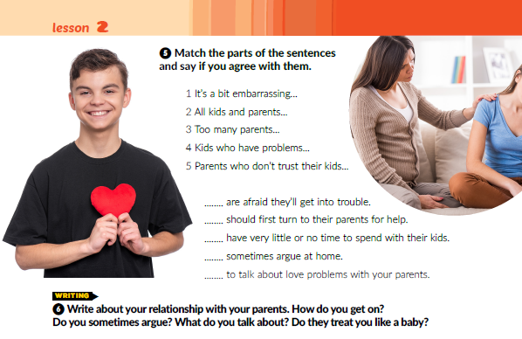
5
4
3
2
1

Slide 6
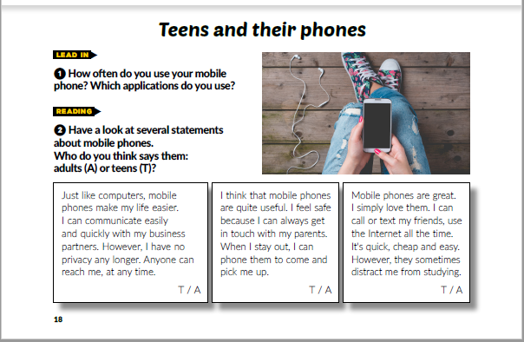
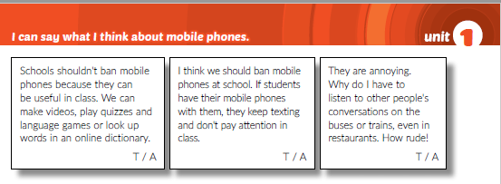
A
T
T
T
A
A

Slide 7
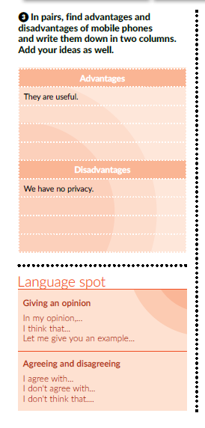
You can get in touch with your parents.
You can use the Internet all the time.
You can make videos, play quizzes and look up words in online dictionaries
They can distract you from studying
Students don’t pay attention in class if they use mobile phones.
People talk loudly on the phone and that’s rude

Slide 8
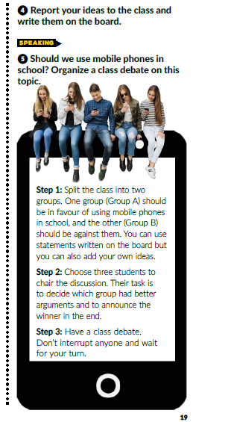
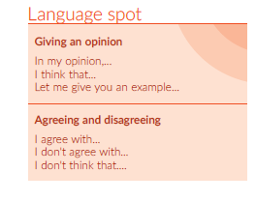
Give your opinion about mobile phones and start your sentences like this:

Slide 9
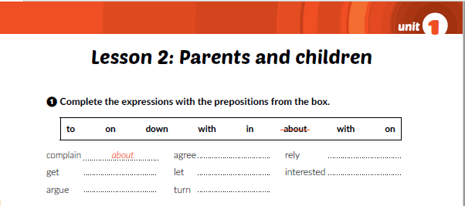
with
on
on
down
in
with
to
Workbook p. 9

Slide 10
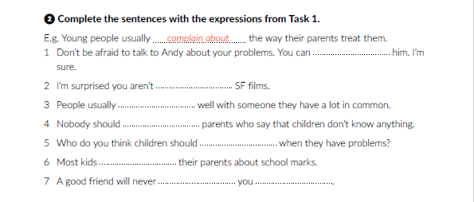
Workbook p. 9
rely on
interested in
get on
agree with
turn to
argue with
let
down

Slide 11
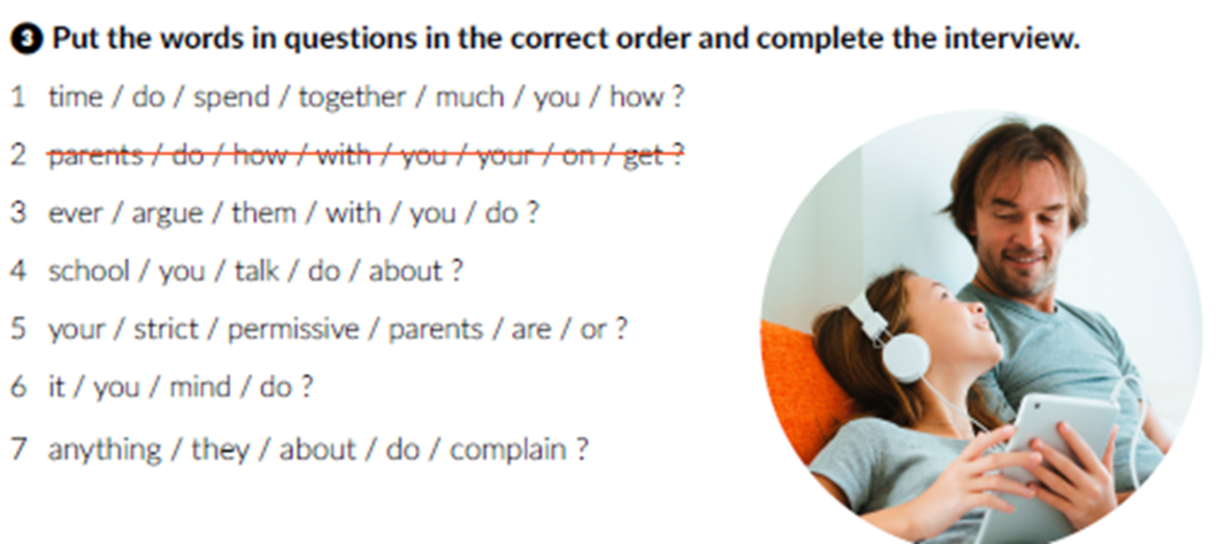
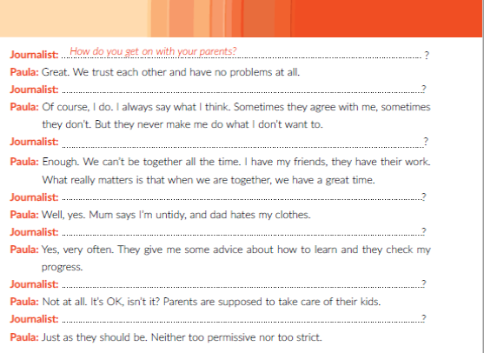

1. How much time do you spend together?
How much time do you spend together?
3. Do you ever argue with them?
Do they complain about anything?
4. Do you talk about school?
5. Are your parents strict or permissive?
Do you talk about school?
6. Do you mind?
Do you mind it?
7. Do they complain about anything?
Are your parents strict or permissive?

Slide 12
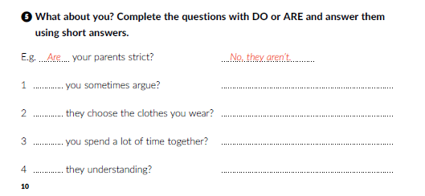
Workbook p. 10
Do
Yes, we do. / No, we don’t
Do
No, they don’t. / Yes, they do.
Do
Yes, we do. / No, we don’t
Are
Yes, they are. / No, they aren’t.

Slide 13
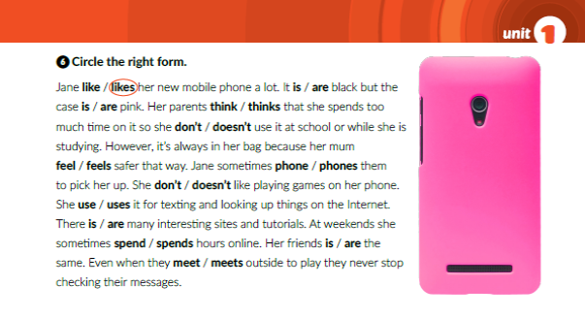

Slide 14

Otvori sljedeću poveznicu, te odaberi PLAY AND LEARN!
Lesson 2 Parents and children | Way to go 4 (e-sfera.hr)

